Slide 1
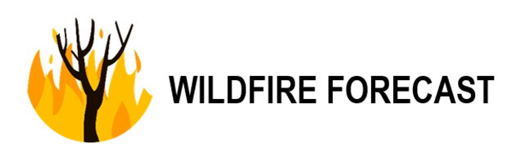

Halima Khalifa (U16106701)
Fady A M Abulebda (U17105389)
Reema Mousa (U17100706)
Maryam Ali (U17101015)
Omar Yaseen (U18101281

Slide 2
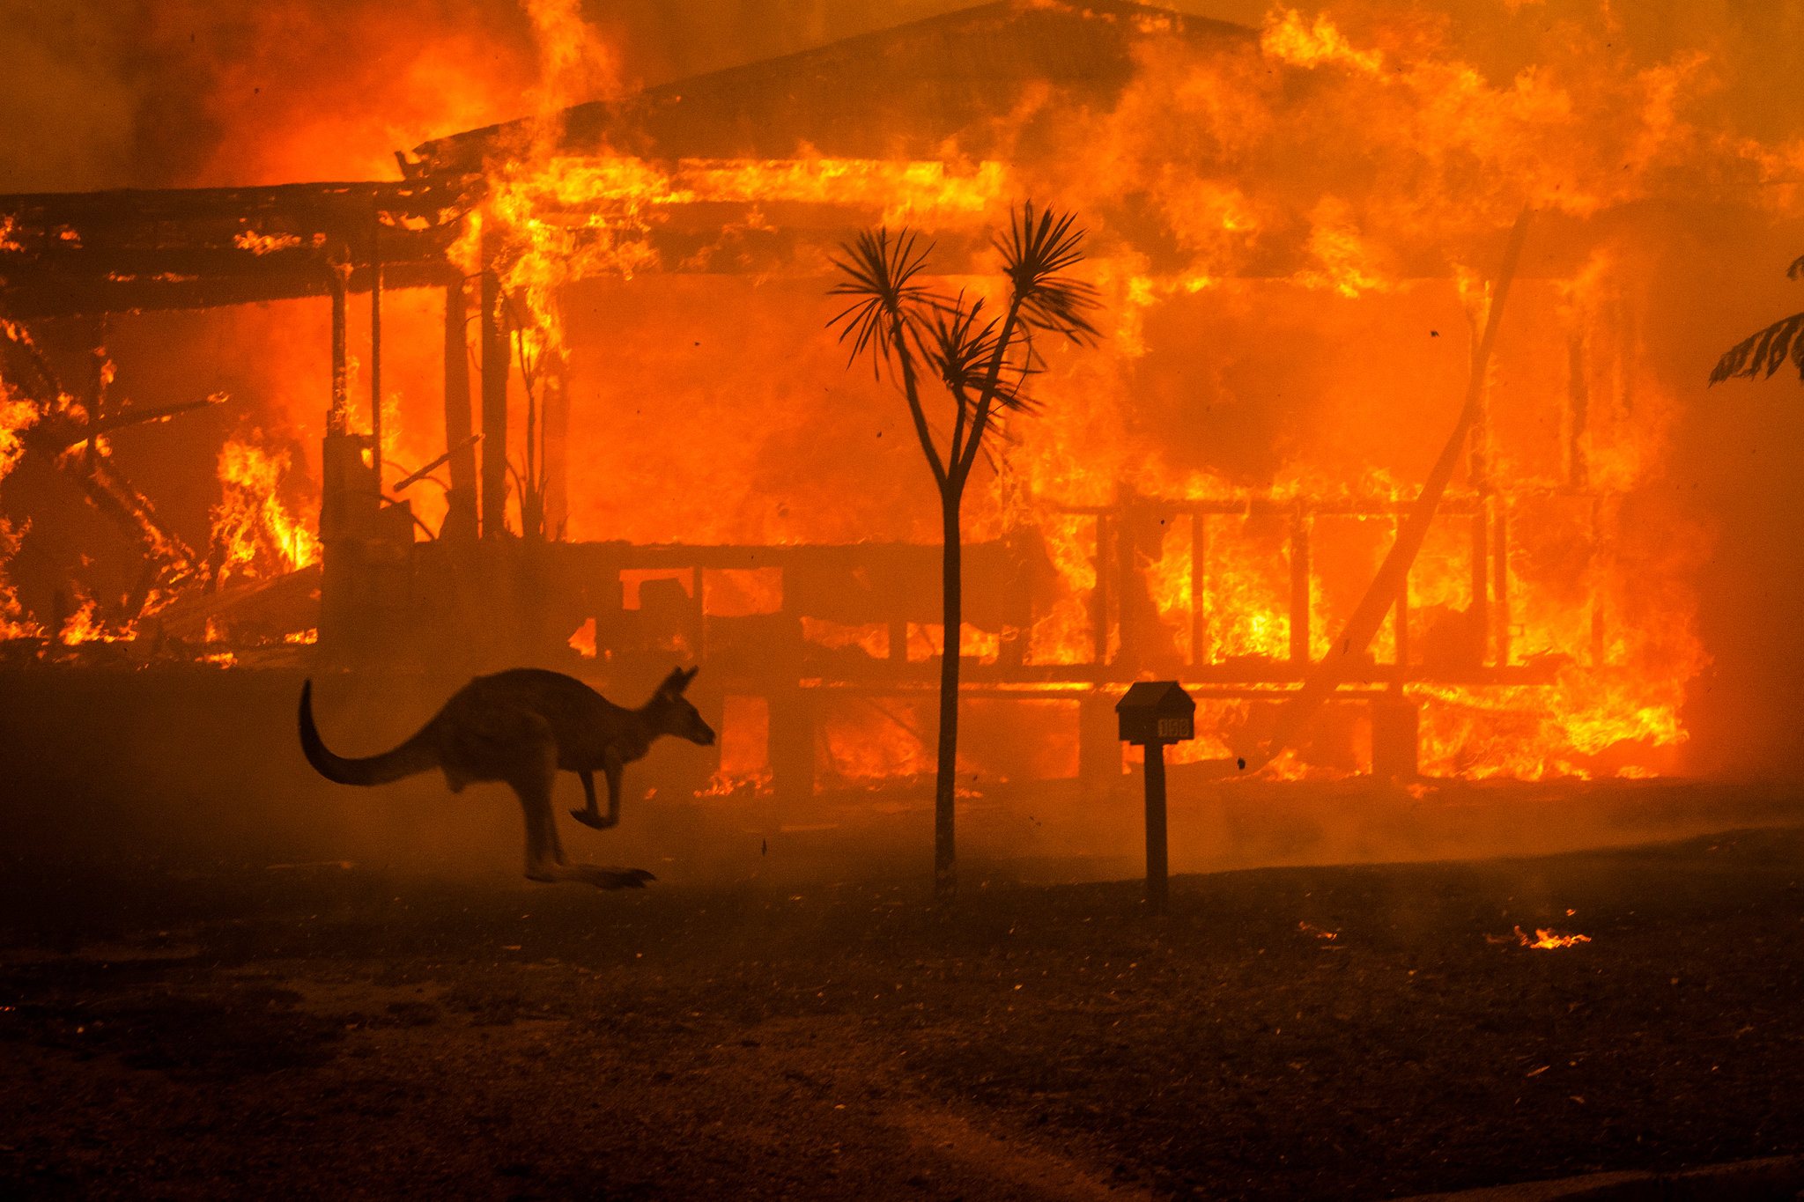
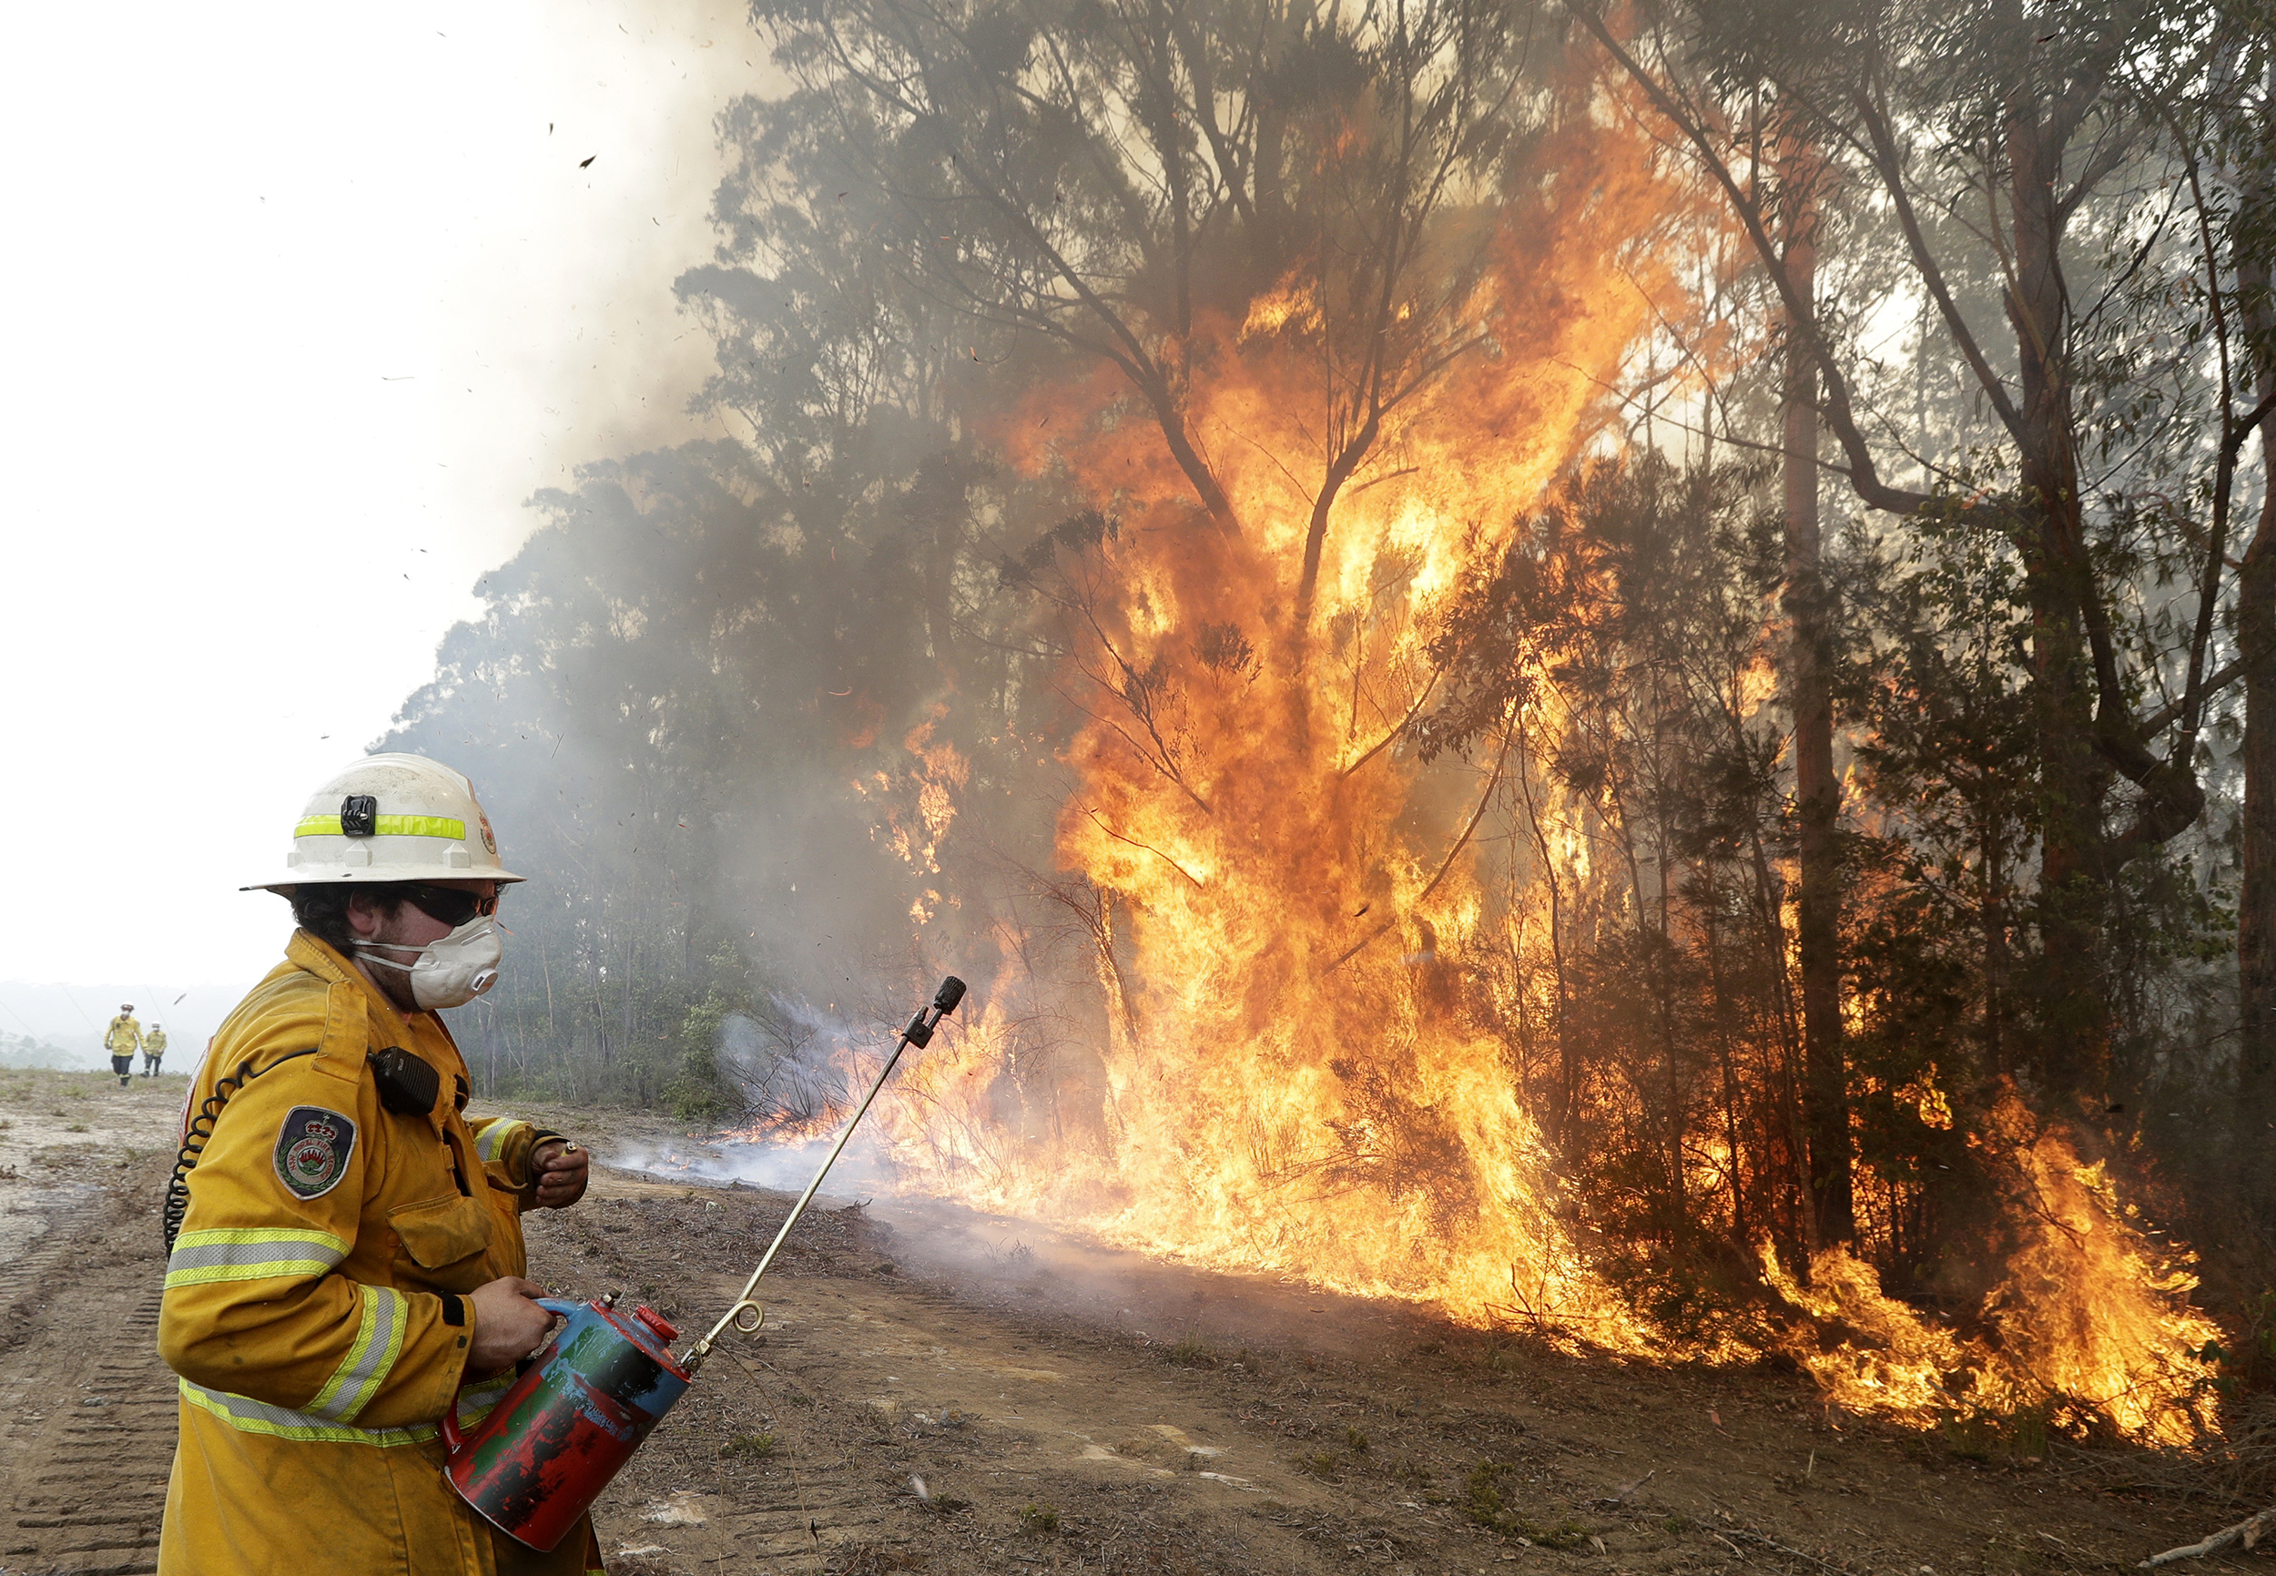
Introduction :
The main goal of the project is to successfully develop an effective software that helps to predict wildfires in Australia for the upcoming wildfire season .

Slide 3
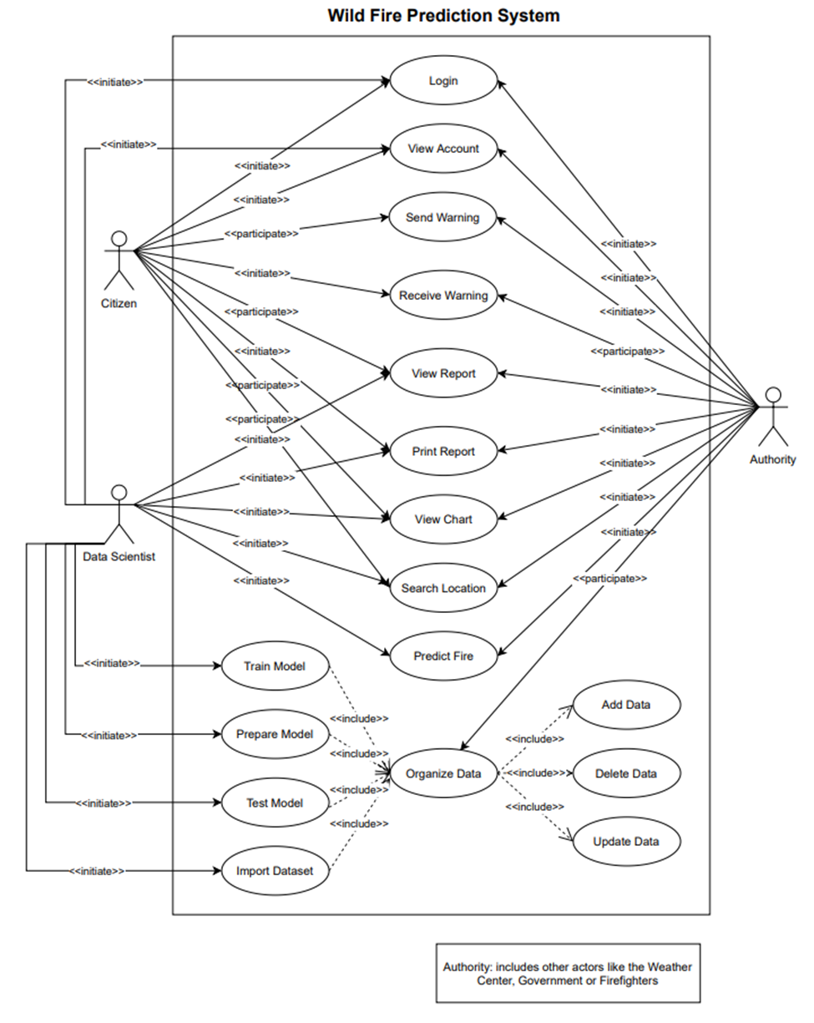
Use case :

Slide 4
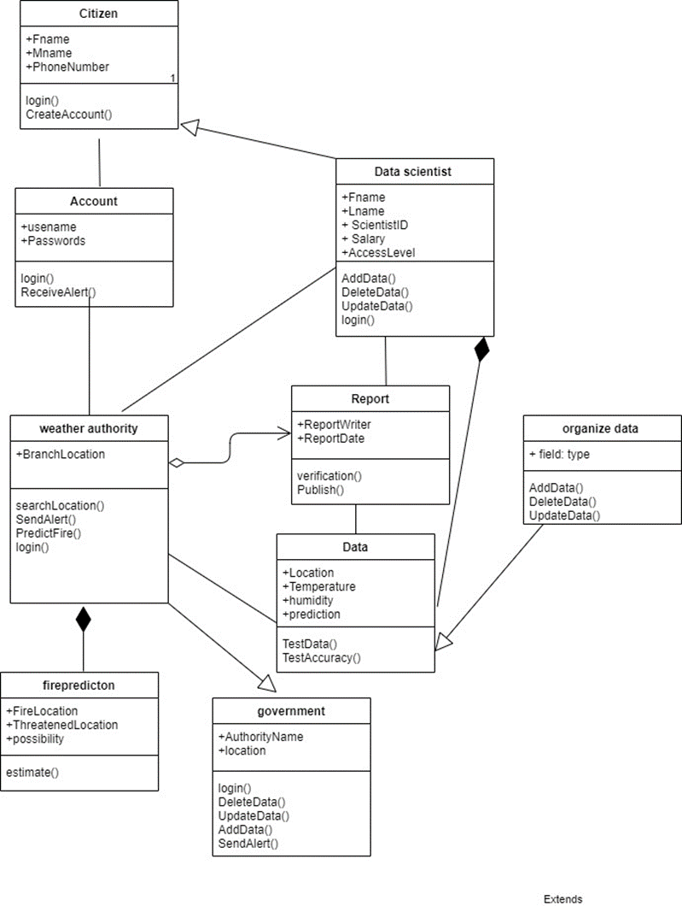
Class diagram :

Slide 5
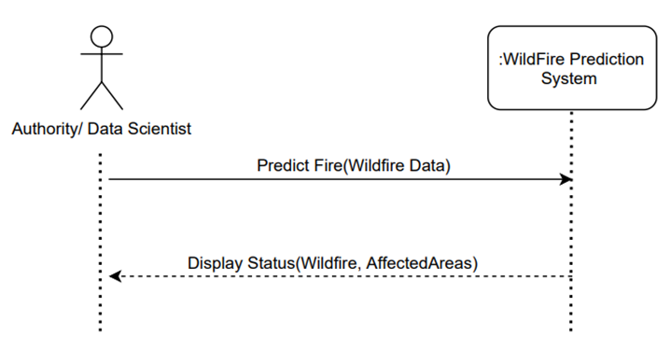
Sequence diagram :
The Wildfire Prediction System will return the affected areas and the prediction of wildfire .

Slide 6
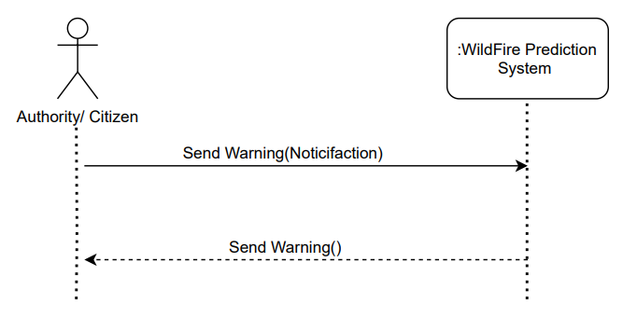
Sequence diagram :
The administrator/government can activate the alert .

Slide 7
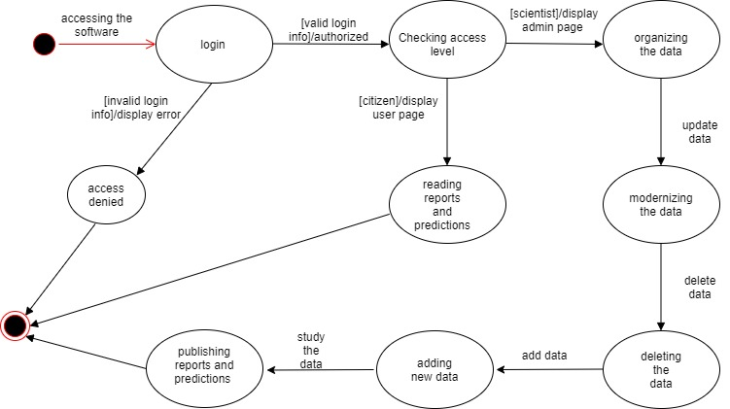
Statechart diagram :
Data Scientist
The data scientist will login to the software to organize data and writing repotrs and making predictions .

Slide 8
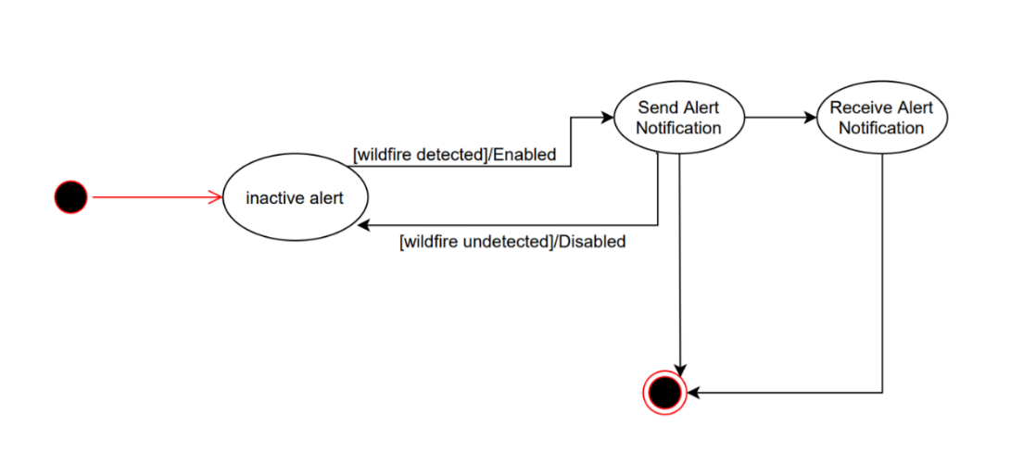
Statechart diagram :
Warning Alert
When the Data Scientist & Authority detects any kind of Wild fires the Authority will send out a notification alert to all the citizens registered in the system.

Slide 9
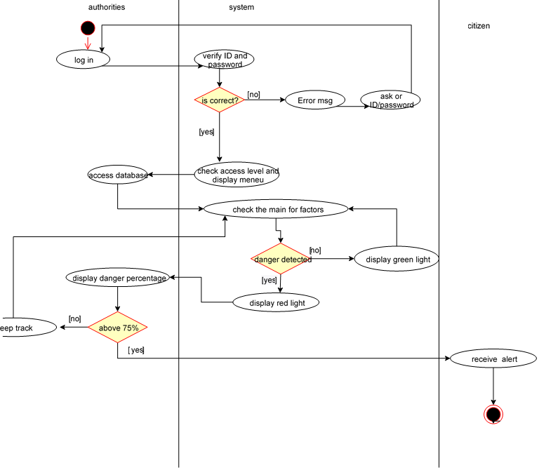
Activity diagram :
Check fire prediction
-The authority will log-in to the system check the main factors. The system will verify the ID and password. It will send an error message for incorrect ID and password and prompt for login again, indefinitely. Once the ID and password is verified, the system will check the access level of the user and display the menu accordingly. If the system detect danger it will notify the authorities if the danger is above 75% the authorities will send an alert to the citizens but id the danger is less than 75% the authorities will keep track.
k

Slide 10
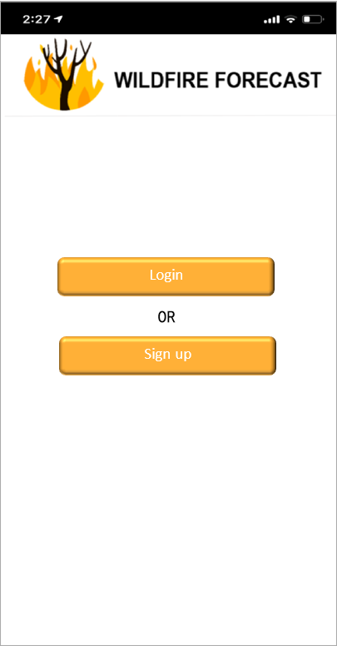
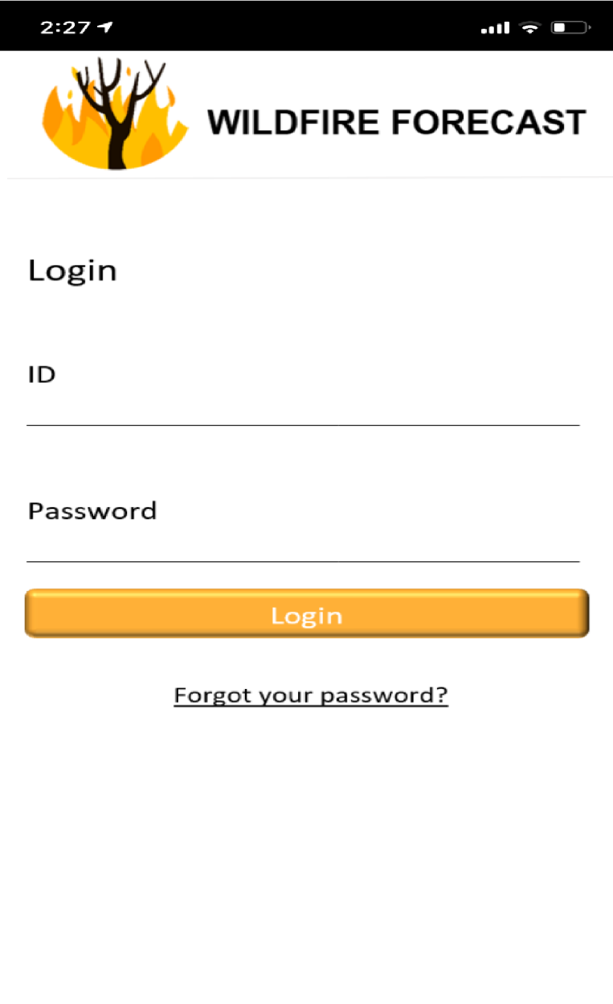
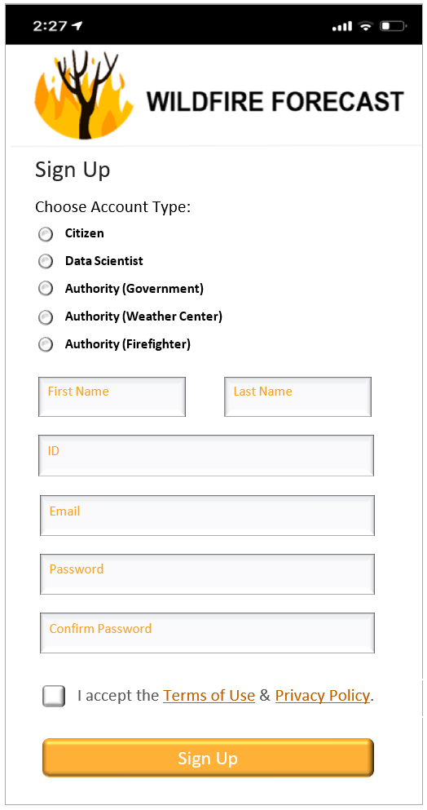
GUIs of the system :
Splash page :
Login page :
SignUp page :

Slide 11
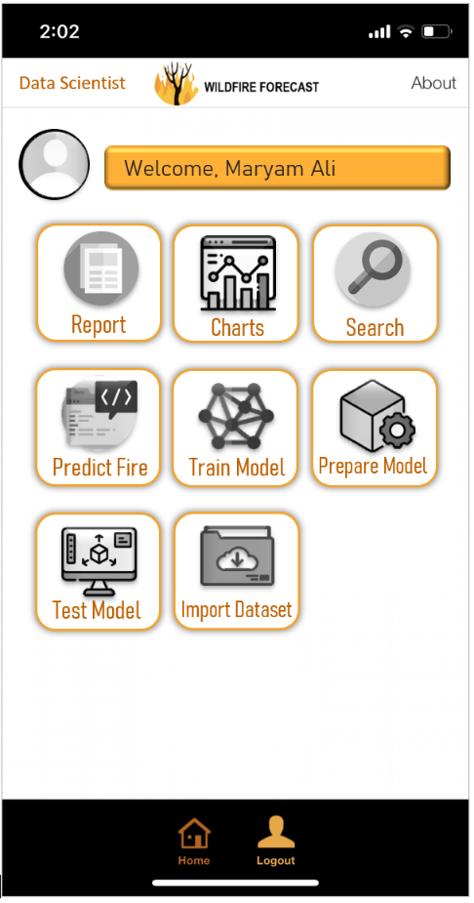
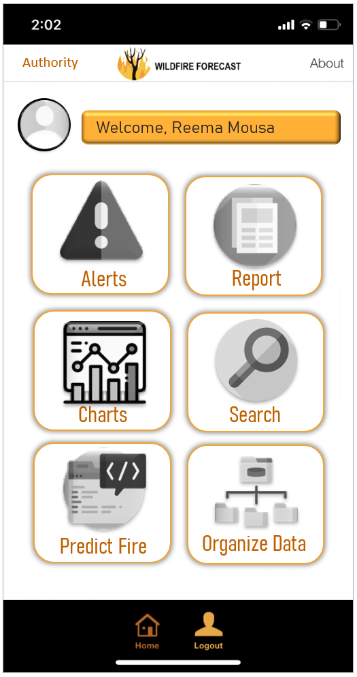
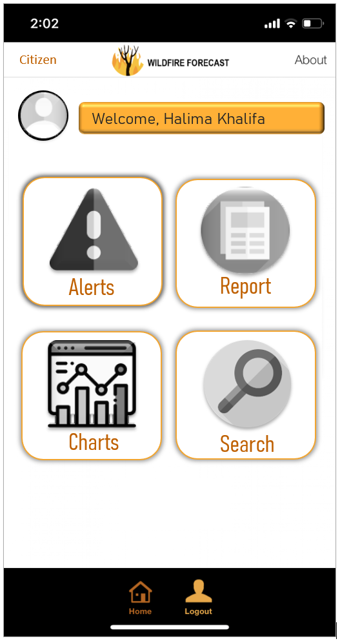
GUIs of the system :
Data scientist page:
Authority Page :
Citizen Page :

Slide 12
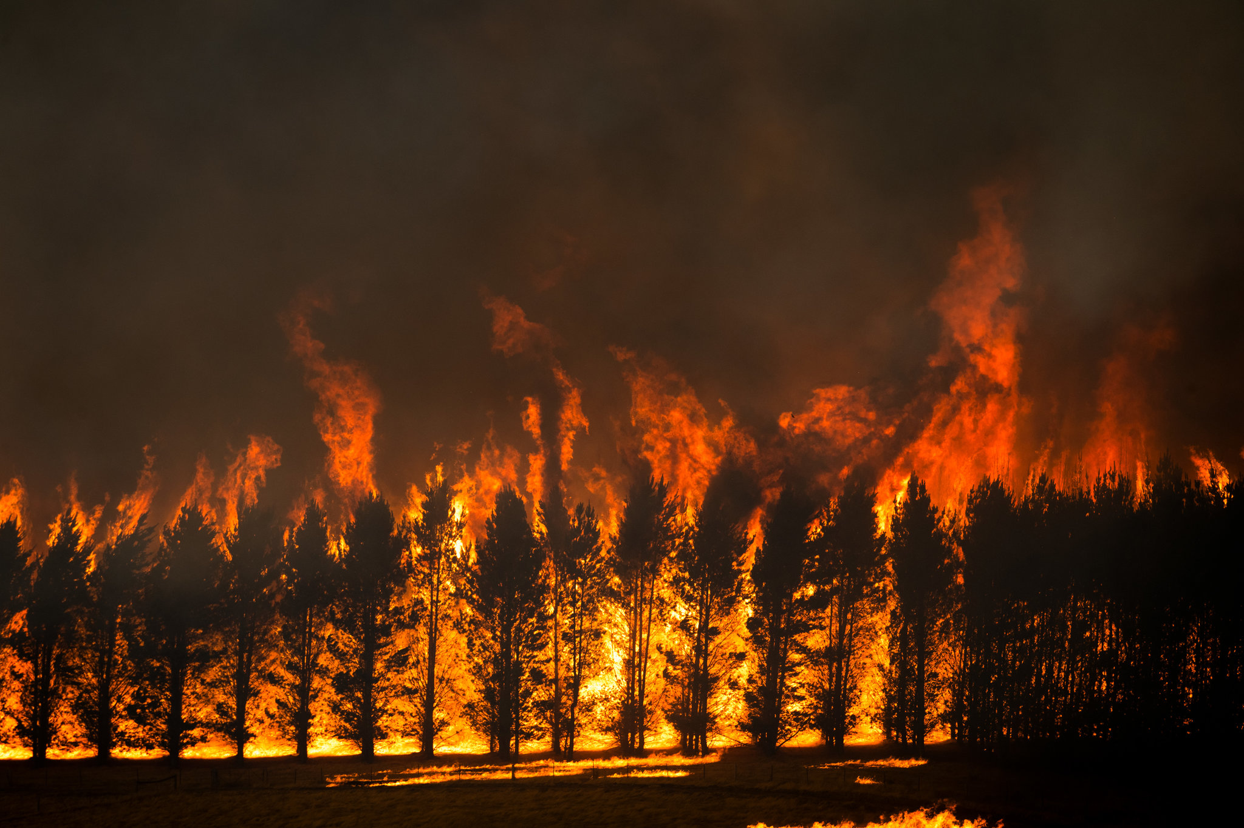
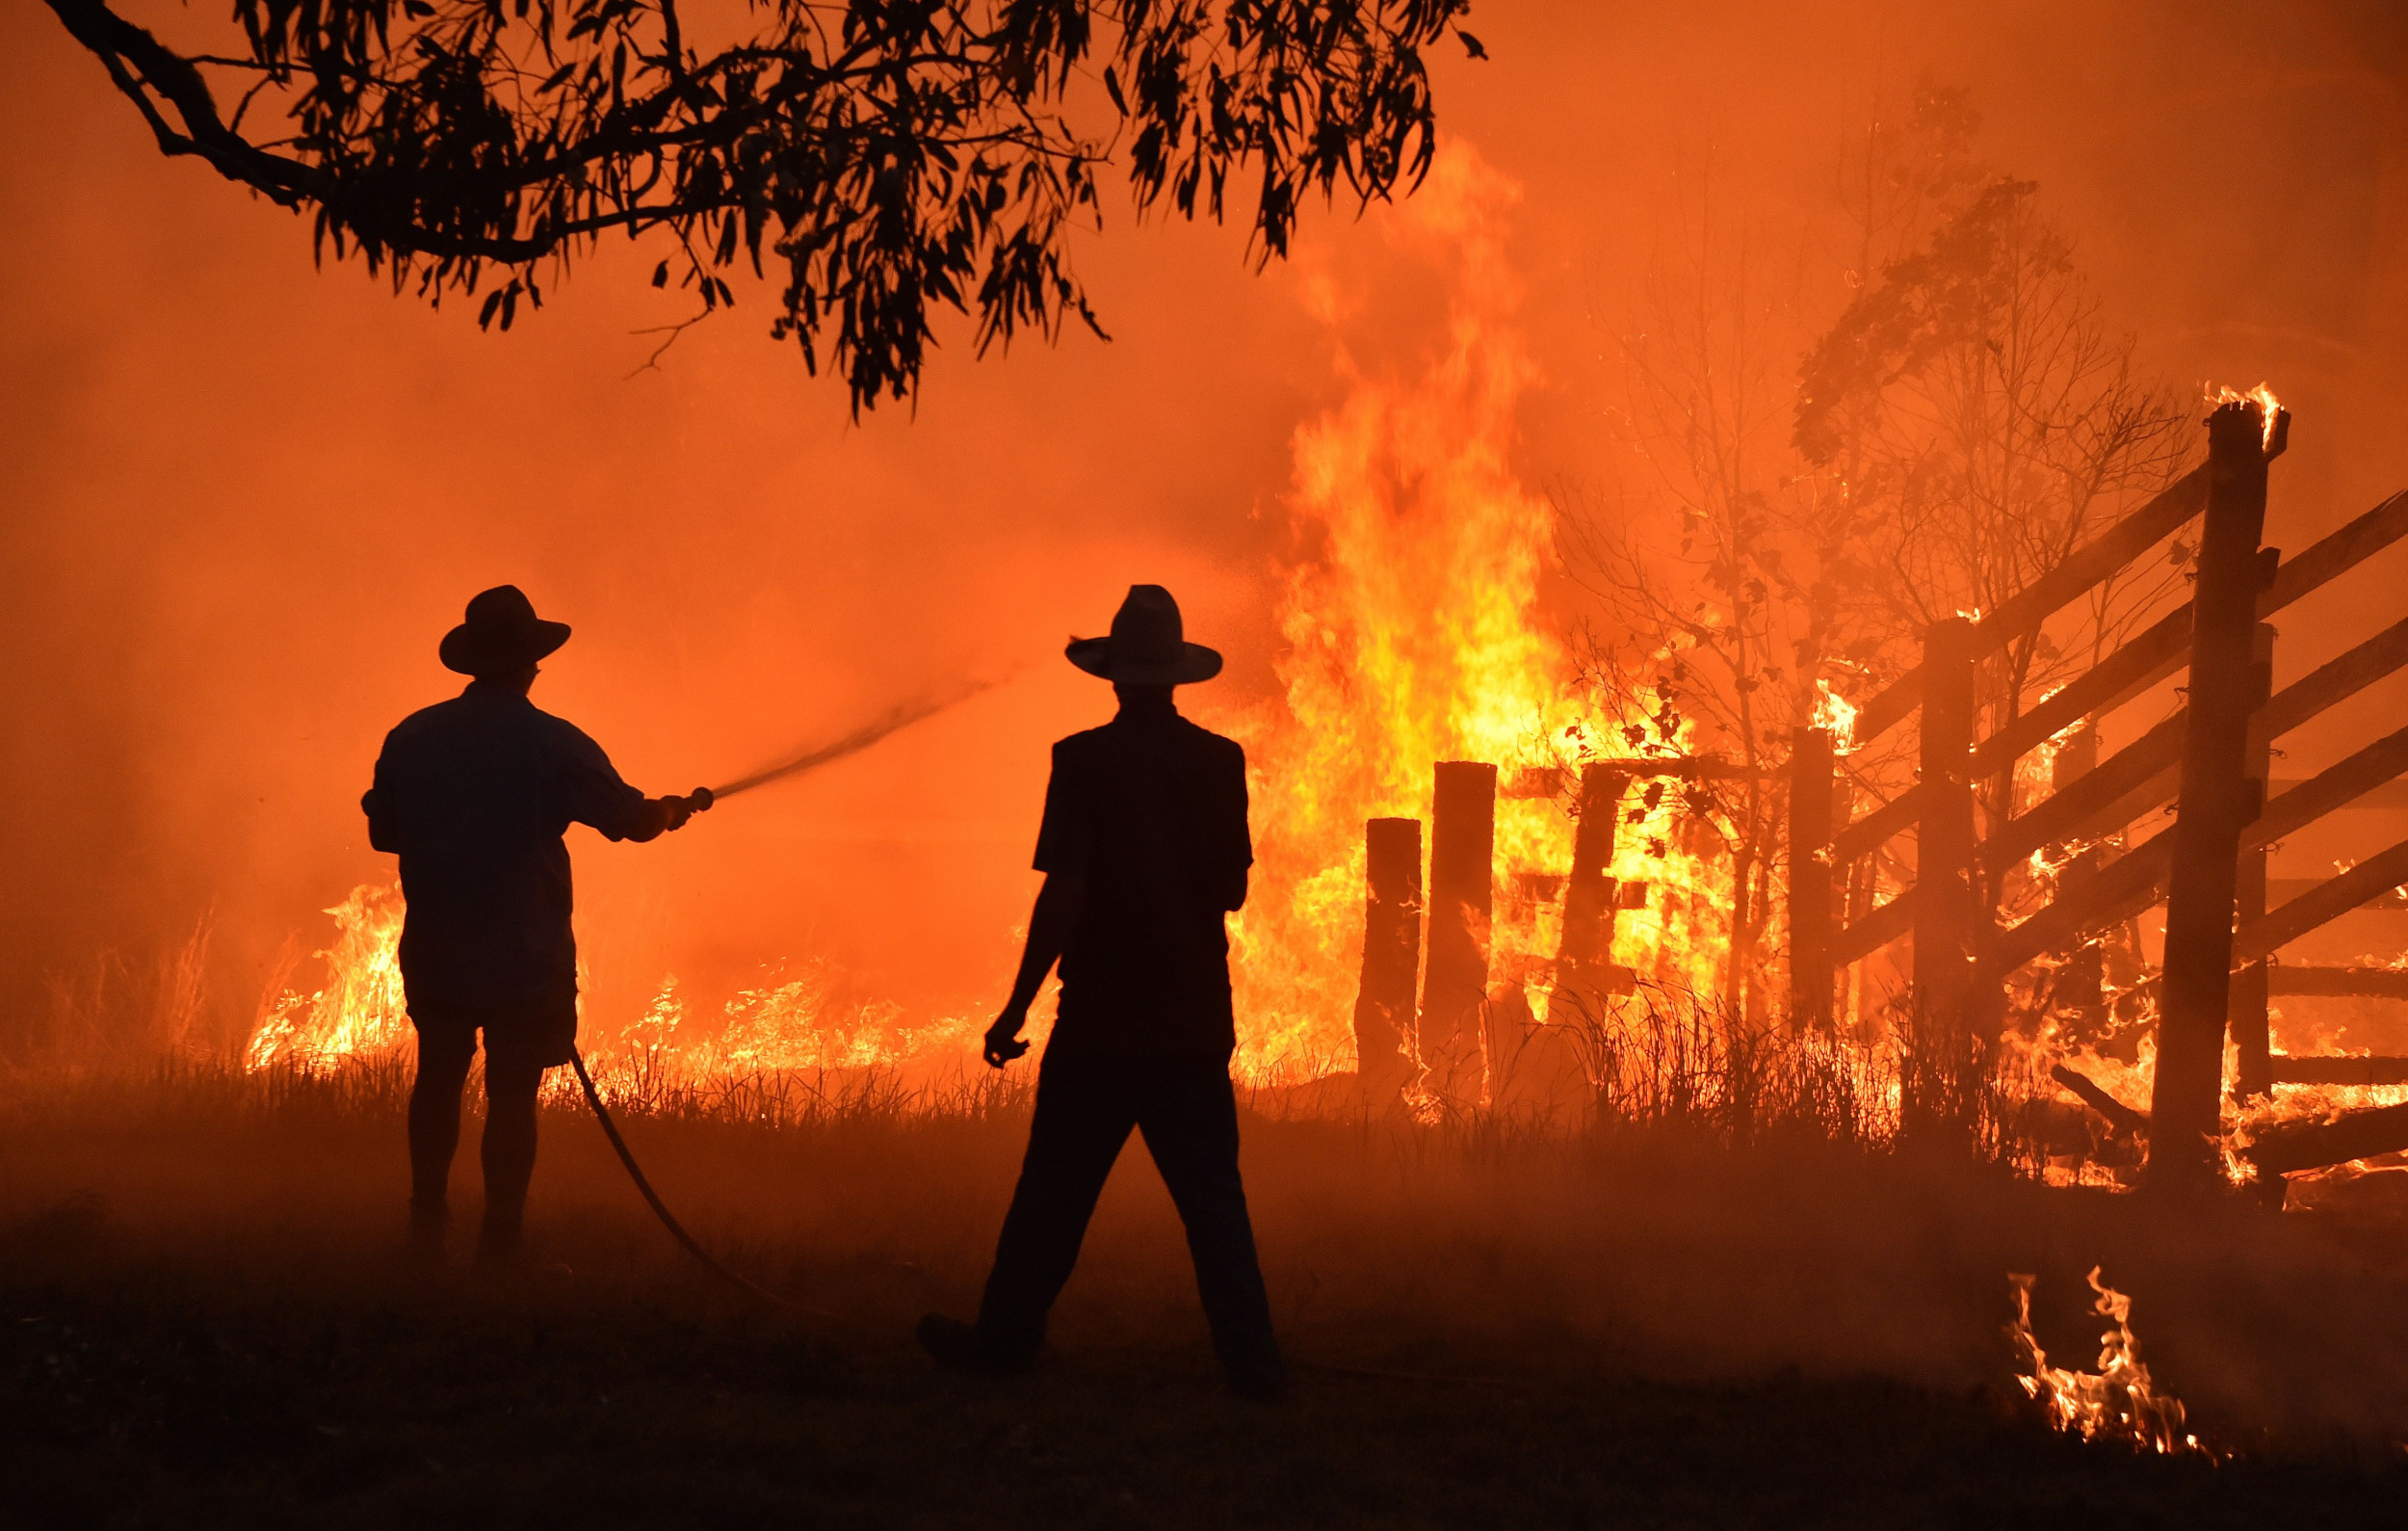
Conclusion :
In conclusion, our software is created to predict the wildfires in Australia for the upcoming seasons, it will maintain all information needed to have a good prediction, locations , temperature , humidity and wind , The system will maintain relevant information and have functions for each component .

